Slide 1

HOME PRICE FACTORS
Based on 2006-2010 home sales in Ames, IA

Slide 2
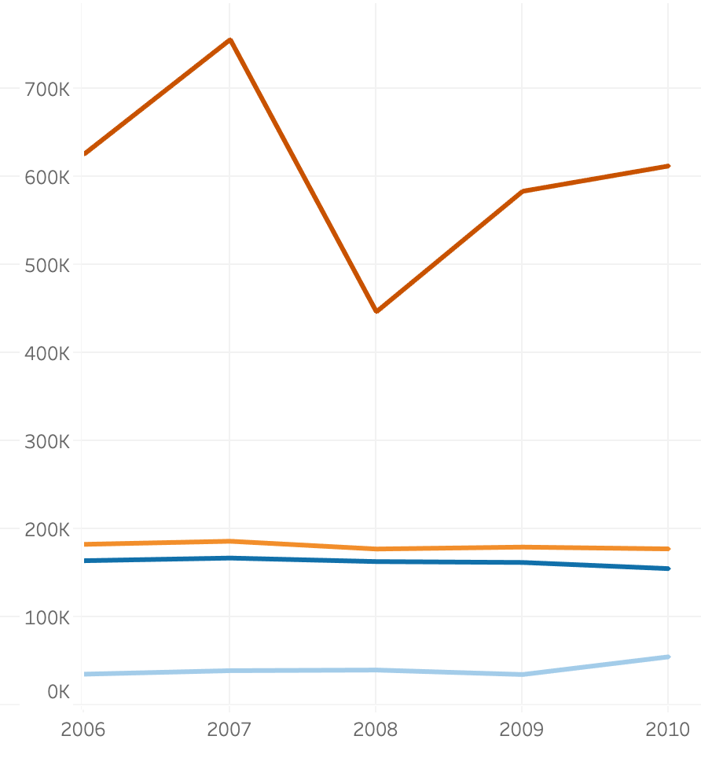
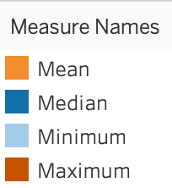

Overall Distribution and Trends

Slide 3

WHAT AFFECTS HOME VALUE?
A/B tests to determine whether or not a characteristic of the home affects sales price
Five years worth of home sales in Ames provided to draw conclusions
The following variables were tested: Modern-esq (built after 1990), House condition, Central Air, and if the house has a Fireplace or not.

Slide 4
Houses Built After 1990
Overall Condition
We can see that houses built after 1990 has no effect on the sales value of a home.
Rejected the null at P=2.09163E-86
Confidence Interval 7991.95
Condition of the home also had no effect on the sales value. ”Bad” category had ratings 1-6, while “Good” had 7-10.
Rejected the null at P=0.1157949
Confidence Interval 15024.63
After Before
Bad Good

Slide 5
Central Air
Fireplace
It’s clear that having Central AC has no effect on the sales value of a home.
Rejected the null at P=9.2742E-37
Confidence Interval 9308.54
Whether or not a house has a fireplace, it seems they do not majorly affect the price as well.
Rejected the null at P=4.62583E-84
Confidence Interval 6978.28
Central Air No Central Air
Worse Better

Slide 6


LOOKING TO THE FUTURE
New Houses, and Overall Condition
Additional Tests: Central Air or Fireplace
Invest with confidence
Ease of selection
Be ahead of market trends

Slide 7
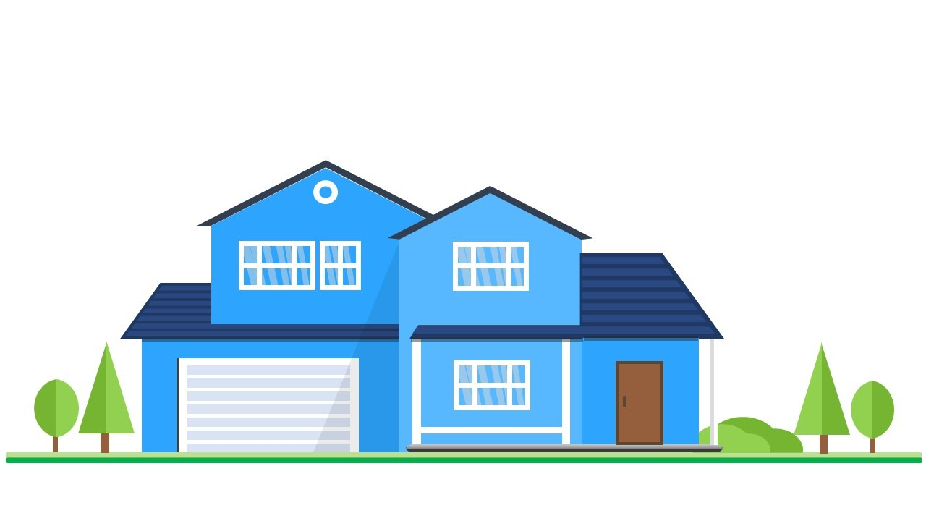
Our Recommendation
Houses by Neighborhood
Price Range

Slide 8
QUESTIONS?
Capstone presentation by Tay Nguyen for Thinkful Data Analysis Immersion Program.

